Slide 1
Foodborne Illnesses
CIT Distance Learning
FPF Introductory Topics

Slide 2

Control Measures
Key concepts
  Proper Handwashing
  No Bare Hand Contact
  Employee Health Policy
"Three-legged stool"
Proper Handwashing
No Bare Hand Contact with RTE Foods
Health Policy / Exclusions & Restrictions

Slide 3
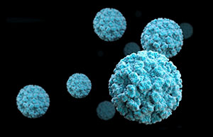
Norovirus
Norovirus is highly infectious
Symptoms
Vomiting
Diarrhea
Nausea
Control Measures
Shellstock from approved sources
Three-legged stool
Sources
Food-handlers
Shellstock from contaminated waters

Slide 4
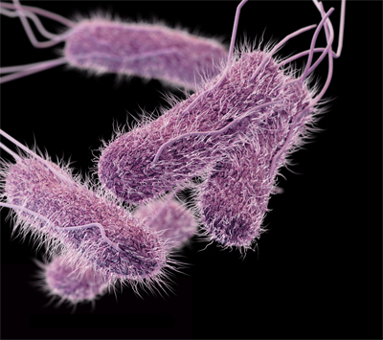
Salmonella typhi
Causes typhoid fever
Symptoms
Diarrhea
Stomach pain
Headache
Control Measures
Three-legged stool
Cook food properly
Prevent cross-contamination
Sources
Food-handlers
Ready to eat foods
Beverages

Slide 5
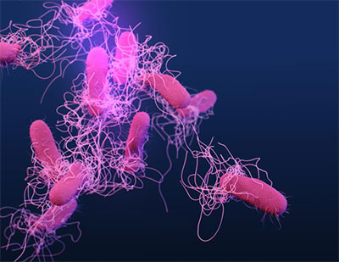
Salmonella
Non-typhoidal
Symptoms
Vomiting
Nausea
Cramps
Fever
Control Measures
Cook food properly
Cool foods quickly
Prevent cross-contamination
Three-legged stool
Sources
Raw and undercooked eggs
Raw and undercooked poultry/meats
Dairy products
Produce
Food-handlers

Slide 6
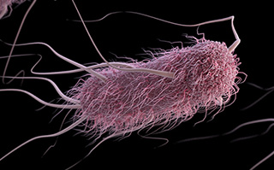
Escherichia coli
Shiga toxin-producing E.coli
Symptoms
Severe diarrhea, sometimes bloody
Dehydration
Cramps
Renal (kidney) failure, severe cases
Control Measures
Cook ground beef properly
Prevent cross-contamination
Wash produce
Food from approved sources
Three-legged stool
Sources
Raw ground beef
Produce
Raw milk
Food-handlers

Slide 7
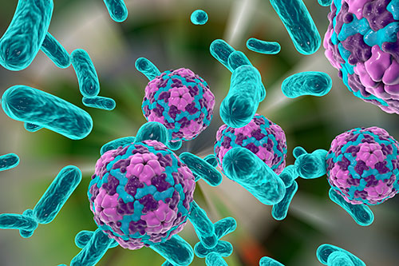
Hepatitis A
Disease of the liver, long incubation period
Symptoms
Diarrhea
Nausea
Fever
Jaundice (yellowing of eyes/skin)
Control Measures
Shellstock from approved sources
Three-legged stool
Sources
Ready to eat foods
Shellstock from contaminated waters
Food-handlers

Slide 8
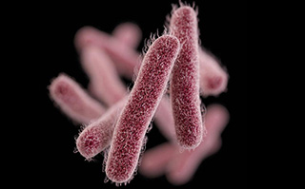
Shigella
Symptoms
Diarrhea
Cramps
Dehydration
Fever/chills
Control Measures
Three-legged stool
Control flies
Wash produce thoroughly
Sources
Food-handlers
Foods easily contaminated by hands, such as salads
Contaminated water
Flies

Slide 9
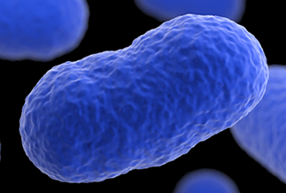
Listeria monocytogenes
Symptoms
Flu-like symptoms
Pregnant women – possible miscarriage
Newborns – pneumonia, meningitis, sepsis
Headache
Sources
Ready to eat foods
Unpasteurized dairy products
Produce
Control Measures
Control time and temperature
Cook foods properly
Food from approved sources
Prevent cross-contamination

Slide 10
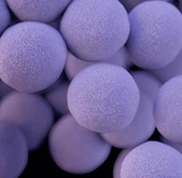
Staphylococcus aureus
Toxin-producing bacteria
Symptoms
Vomiting
Diarrhea
Nausea
Stomach cramps
Control Measures
Three-legged stool
Time and temperature control
Food cooled quickly
Do not work with skin infections or wounds on hands or arm
Sources
Food-handlers
Ready to eat foods

Slide 11
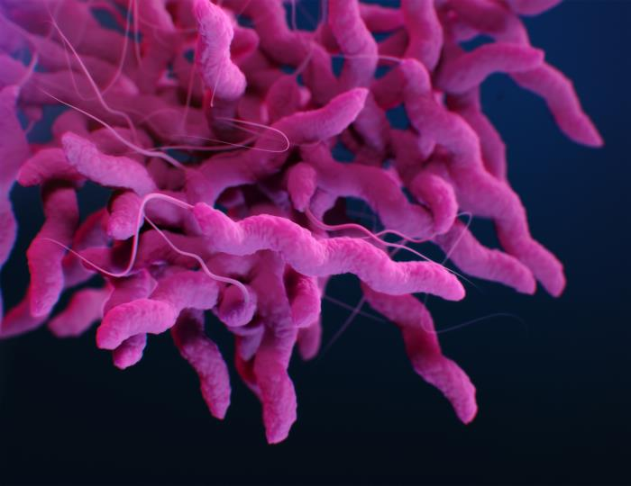
Campylobacter jejuni
Symptoms
Vomiting
Diarrhea (bloody/watery)
Fever
Stomach cramps
Control Measures
Cook foods properly
Time and temperature control
Prevent cross-contamination
Sources
Poultry
Contaminated water
Raw milk

Slide 12
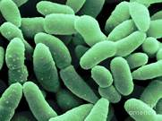
Clostridium perfrigens
Symptoms
Diarrhea
Severe abdominal pain
Control Measures
Cool foods quickly
Reheat foods properly
Time and temperature control
Sources
Poultry/meat
Stews/gravies made with meat and poultry

Slide 13
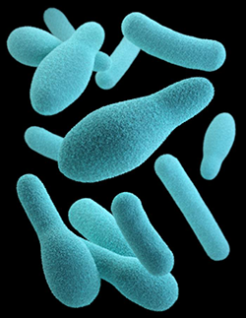
Clostridium botulinum
Spore-forming bacteria
Symptoms
Initially: Nausea and vomiting
Later: Double-vision, difficulty speaking/swallowing, possible death
Control Measures
Cool, hold, and reheat foods correctly
Inspect canned foods for damage
Time and temperature control
Sources
Incorrectly canned foods
Reduced-oxygen packaged (ROP) foods
Temperature-abused vegetables (baked potatoes)
Untreated garlic-and-oil mixtures

Slide 14
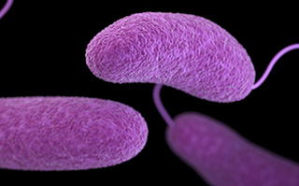
Vibrio spp.
Vibrio vulnificus and Vibrio parahaemolyticus
Symptoms
Diarrhea
Vomiting
Cramps/abdominal pain
Fever/chills
Control Measures
Cook oysters properly
Purchase oysters from an approve source
Source
Oysters from contaminated waters

Slide 15
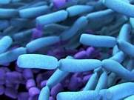
Bacillus cereus
Symptoms
Watery diarrhea
Vomiting
Nausea
Control Measures
Cook, hold, and cool food properly
Time and temperature control
Sources
Cooked vegetables, such as rice
Meat
Milk

Slide 16
END OF PRESENTATION
If you have any questions about this presentation, please contact your Regional Specialist.

