Slide 1
Mass Gatherings
Title 15A Subchapter 18A .1401 through .1426
North Carolina General Statutes 130A-252 through 256
Notes:
-Welcome.
-This presentation will provide an overview for the Mass Gathering Rules.
-These rules can be found under Title 15A Subchapter 18A .1401-1426.
-In addition, we will discuss requirements for Mass Gatherings listed under NC General Statutes 130A-252 through 256.

Slide 2
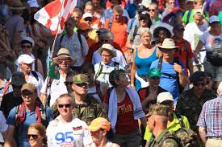
Definition of Mass Gathering (G.S. 130A-252)
A congregation of more than 5000 people in an open space or open air for a period of more than 24 hours
Includes congregations and assemblies organized and held for any purpose
Does not include:
Assemblies in permanent buildings designed for use by large groups
Annual event in a permanent stadium with adjacent campground that has attracted 70,000+ in the past five years (speedways/drag ways)
Notes:
-“Mass gathering" means a congregation or assembly of more than 5,000 people in an open space or open air for a period of more than 24 hours. A mass gathering shall include all congregations and assemblies organized or held for any purpose, but shall not include assemblies in permanent buildings or permanent structures designed or intended for use by a large number of people.
-To determine whether a congregation or assembly extends for more than 24 hours, the period shall begin when the people expected to attend are first permitted on the land where the congregation or assembly will be held and shall end when the people in attendance are expected to depart. To determine whether a congregation or assembly shall consist of more than 5,000 people, the number reasonably expected to attend, as determined from the promotion, advertisement and preparation for the congregation or assembly and from the attendance at prior congregations or assemblies of the same type, shall be considered.
-The provisions of this Part do not apply to a permanent stadium with an adjacent campground that hosts an annual event that has, within the previous five years, attracted crowds in excess of 70,000 people. The term "stadium" includes speedways and dragways.

Slide 3

Permit Required (G.S. 130A-253)
A mass gathering permit:
Is required for each event and is not transferable
May be revoked at any time when in violation of conditions
Expires upon completion of post-gathering cleanup and closure
For a proposed event, the organizer/promoter must submit an information report about the event to the Health Department within five calendar days
If deemed a mass gathering, the organizer/promoter must submit an application for a permit at least 30 days prior to the event
Notes:
-No person shall organize, sponsor or hold any mass gathering unless a permit has been issued to the person by the Secretary under the provisions of this Part. A permit shall be required for each mass gathering and is not transferable.
-A permit may be revoked by the Secretary at any time if the Secretary finds that the mass gathering is being or has been maintained or operated in violation of this Part. A permit may be revoked upon the request of the permittee or upon abandonment of the operation. A permit will otherwise expire upon satisfactory completion of the post-gathering cleanup following the close of the mass gathering.
-The Secretary, upon information that a congregation or assembly of people which may constitute a mass gathering is being organized or promoted, may direct the organizer or promoter to submit within five calendar days an information report to the Department. The report shall contain the information required for an application for permit under G.S. 130A-254(b) and other information concerning the promotion, advertisement and preparation for the congregation or assembly and prior congregations or assemblies, as the Secretary deems necessary. The Secretary shall consider all available information including any report received and shall determine if the proposed congregation or assembly is a mass gathering. If the Secretary determines that a proposed congregation or assembly is a mass gathering, the Secretary shall notify the organizer or promoter to submit an application for permit at least 30 days prior to the commencement of the mass gathering.

Slide 4

Application for Permit (G.S. 130A-254)
Application for a permit:
Submitted to the Health Department at least 30 days prior to the event
Fee cannot exceed $100
Applicant/organizer information
Dates/times of the event
Map of area used (to scale) with required amenities located
Any other plans or information required by the Health Department
Separate charges possible for cost of additional resources (police/fire services)
Notes:
-Application for a permit for a mass gathering shall be made to the Secretary on a form and in a manner prescribed by the Secretary. The application shall be filed with the Secretary at least 30 days prior to the commencement of the mass gathering. A fee as prescribed by the Secretary, not to exceed one hundred dollars ($100.00), shall accompany the application.
-The application shall contain the following information: identification of the applicant; identification of any other person or persons responsible for organizing, sponsoring or holding the mass gathering; the location of the proposed mass gathering; the estimated maximum number of persons reasonably expected to be in attendance at any time; the date or dates and the hours during which the mass gathering is to be conducted; and a statement as to the total time period involved.
-The application shall be accompanied by an outline map of the area to be used, to approximate scale, showing the location of all proposed and existing privies or toilets; lavatory and bathing facilities; all water supply sources including lakes, ponds, streams, wells and storage tanks; all areas of assemblage; all camping areas; all food service areas; all garbage and refuse storage and disposal areas; all entrances and exits to public highways; and emergency ingress and egress roads.
-The application shall be accompanied by additional plans, reports and information required by the Secretary as necessary to carry out the provisions of this Part.
-A charge shall be levied by the Secretary to cover the cost of additional services, including police, fire and medical services, provided by the State or units of local government on account of the mass gathering. The Secretary shall reimburse the State or the units of local government for the additional services upon receipt of payment.

Slide 5

Provisional Permit; Performance Bond; Liability Insurance (G.S. 130A-255)
Application reviewed within 15 days of receipt
Provisional permit issued if applicant will likely meet the requirements for a mass gathering
Once provisional permit issued:
Applicant secures a performance bond within five days for $5,000 for up to 10,000 people, additional $1,000 for each additional 5,000 people or fraction thereof
Applicant provides evidence of public liability/property damage insurance at a reasonable amount, not to exceed $1 million
Notes:
-Within 15 days after the receipt of the application, the Secretary shall review the application and inspect the proposed site for the mass gathering. If it is likely that the requirements of this Part and the rules of the Commission can be met by the applicant, a provisional permit shall be issued.
-The Secretary shall require the permittee within five days after issuance of the provisional permit to file with the Secretary a performance bond or other surety to be executed to the State in the amount of five thousand dollars ($5,000) for up to 10,000 persons and an additional one thousand dollars ($1,000) for each additional 5,000 persons or fraction reasonably estimated to attend the mass gathering. The bond shall be conditioned on full compliance with this Part and the rules of the Commission and shall be forfeitable upon noncompliance and a showing by the Secretary of injury, damage or other loss to the State or local governmental agencies caused by the non-compliance.
-The permittee shall in addition file satisfactory evidence of public liability and property damage insurance in an amount determined by the Secretary to be reasonable, not to exceed one million dollars ($1,000,000) in amount, in relation to the risks and hazards involved in the proposed mass gathering.

Slide 6
Issuance of Permit; Revocation; Forfeiture of Bond; Cancellation (G.S. 130A-256)
Inspection conducted at least five days prior to the event
Permit issued if:
Required facilities in place
Arrangements for required service satisfactory
Fees for additional services paid
Provisional permit revoked and new permit denied if requirements listed above have not been met
If permit is revoked before or during the event, organizer must immediately announce the cancellation of the event
Notes:
-If, upon inspection by the Secretary five days prior to the starting date of the mass gathering, or earlier upon request of the permittee, the required facilities are found to be in place, satisfactory arrangements are found to have been made for required services, the charge for additional services levied in accordance with G.S. 130A-254(e) has been paid and other applicable provisions of this Part and the rules of the Commission are found to have been met, the Secretary shall issue a permit for the mass gathering. If, upon inspection, the facilities, arrangements or other provisions are not satisfactory, the provisional permit shall be revoked and no permit shall be issued.
-Upon revocation of either the provisional permit or the permit, the permittee shall immediately announce cancellation of the mass gathering in as effective a manner as is reasonably possible including, but not limited to, the use or whatever methods were used for advertising or promoting the mass gathering.

Slide 7

Issuance of Permit; Revocation; Forfeiture of Bond; Cancellation (G.S. 130A-256)
For cancelled events:
Permittee makes necessary arrangements for people that may attend the event no matter what
Includes providing safe/sanitary conditions and site cleanup
If permittee fails to make these arrangements, the agency will implement provisions to protect the public health and safety
The agency will seek reimbursement for services provided through the performance bond using the court system
Notes:
-If the provisional permit or the permit is revoked prior to or during the mass gathering, the Secretary may order the permittee to install facilities and make arrangements necessary to accommodate persons who may nevertheless attend or be present at the mass gathering despite its cancellation and to restore the site to a safe and sanitary condition. In the event the permittee fails to comply with the order of the Secretary, the Secretary may immediately proceed to install facilities and make other arrangements and provisions for cleanup as may be minimally required in the interest of public health and safety, utilizing any State and local funds and resources as may be available.
-If the Secretary installs facilities or makes arrangements or provisions for cleanup pursuant to subsection (c), the Secretary may apply to a court of competent jurisdiction prior to or within 60 days after the action to order forfeiture of the permittee's performance bond or surety for violation of this Part or the rules of the Commission. The court may order that the proceeds shall be applied to the extent necessary to reimburse State and local governmental agencies for expenditures made pursuant to the action taken by the Secretary upon the permittee's failure to comply with the order. Any excess proceeds shall be returned to the insurer of the bond or to the surety after deducting court costs.

Slide 8
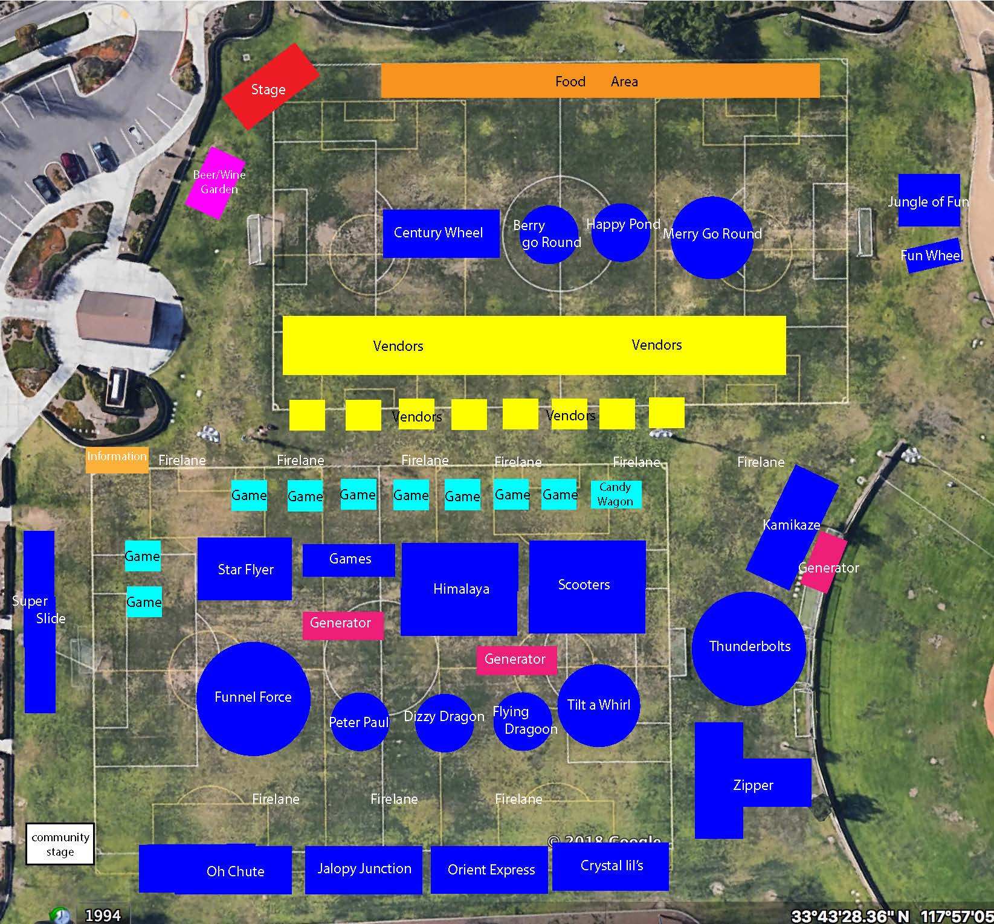
Activity Area (.1404)
Sufficiently sized to accommodate the estimated number of persons reasonably expected to attend any one time
Activity area is in addition to the areas for parking, camping, and the command post
Notes:
-An activity area shall be provided of sufficient size to accommodate the estimated number of persons reasonably expected to be in attendance at any one time.
-This activity area is in addition to those areas required for parking in .1410, for camping in .1407, and for the command post in .1408 of this Section.

Slide 9

Distance From Dwellings (.1405)
Activity and camping areas shall not be within 1500 feet of any residence unless occupant or owner has signed a written waiver
Notarized copies of the written waiver shall accompany the application
Notes:
-No part of the perimeter of the activity and camping areas shall be within 1500 feet of any residence unless the occupant or owner has signed a written waiver.
-Notarized copies of any such waivers shall accompany the application.

Slide 10

Distance From Certain Water; Public Water Supply Sources (.1406)
No parts of the perimeters of the activity, including camping areas shall be located within:
One mile of a Class 1 or 2 reservoir as classified by Division of Environmental Health
Three miles of a protected watershed which drains into an A-I stream as classified by the Division of Environmental Management, and which the stream is used as a source of public water supply.
Notes:
-No part of the perimeters of the activity, including camping areas, shall be located within one mile of a class I or class II reservoir, as classified by the Division of Environmental Health, or within three miles of a protected watershed which drains into an A-I stream, as classified by the Division of Environmental Management, and which stream is used as a source of public water supply.

Slide 11
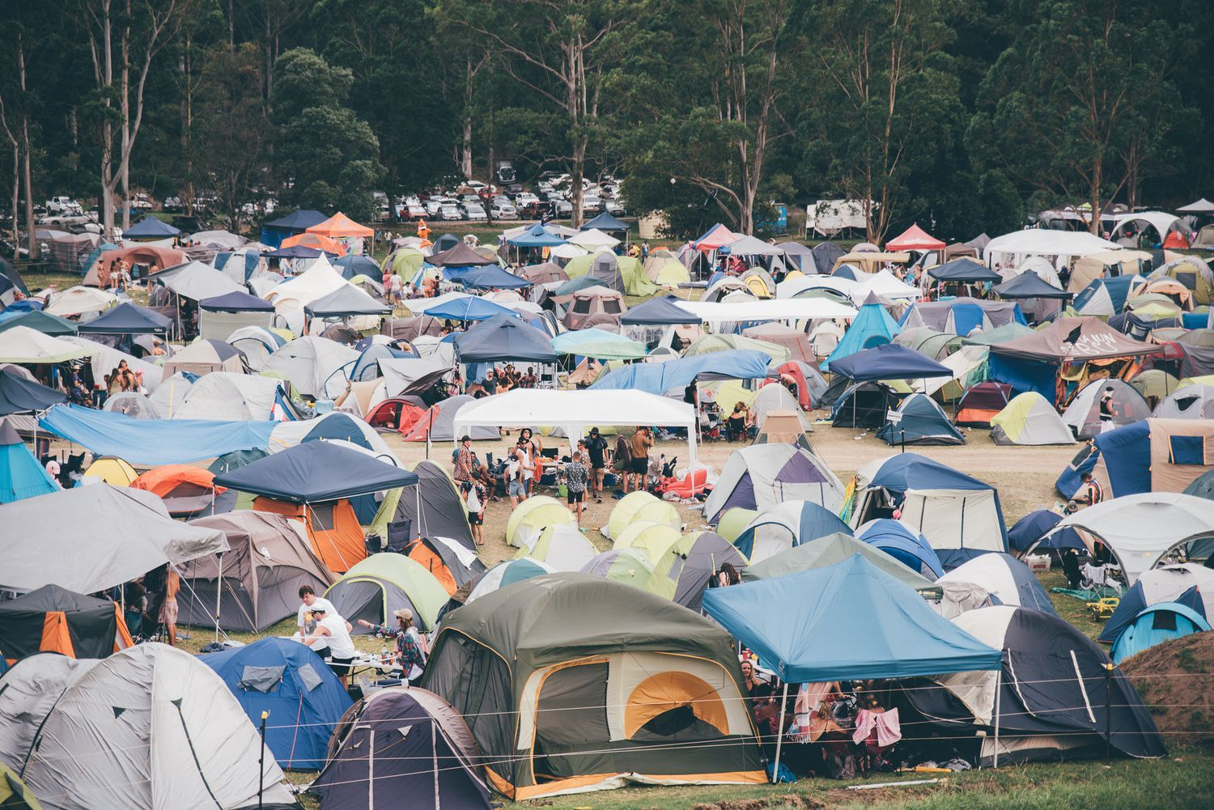
Camping Area (.1407)
Camping areas:
Adequately sized
Provide safe drinking water
Sufficient facilities for sewage collection and disposal
Notes:
-An area of adequate size to accommodate the provision of safe drinking water and sewage collection and disposal shall be provided and designated for camping.
-Such area shall be in addition to the areas provided for activities in Rule .1404 and for parking in Rule .1410 of this Section.

Slide 12

Command Post (.1408)
Command Post:
Convenient location for law enforcement and governmental agencies
Consists of at least one building/mobile unit with telephones, utilities, and parking spaces
Access provided at all times by the permittee
Notes:
-A command post at a conveniently accessible location approved by the Department shall be provided for use by the Department, law enforcement, and other governmental agencies with regulatory authority for such events.
-The command post shall consist of at least one building or mobile unit equipped with telephones, other utilities and parking spaces.
-The permittee shall provide access to the command post at all times for use by the Department and the other entities listed in this Rule

Slide 13

Ingress and Egress Roads: Entrance and Exits (.1409)
Personnel provided and arrangements made to keep entrances and exists to public highways always open to traffic
Arrangements established with private parties or NCDOT regarding adequate ingress and egress roads
Notes:
-The permittee shall provide personnel and arrangements necessary to keep entrances and exits to public highways open to traffic at all times.
-The permittee shall make arrangements with private parties or consult with the North Carolina Department of Transportation and Highway Safety regarding adequate ingress and egress roads.

Slide 14


Parking (.1410)
Spaces provided on basis of one space for every four persons expected
Vehicles used for camping park in the camping area only
No parking allowed on shoulders of public roads, post temporary signage
Notes:
-Parking spaces shall be provided on the basis of one space for every four persons expected to attend.
-Vehicles used for camping shall park in the camping area provided in Rule .1407 of this Section.
-Parking on shoulders of public highways shall not be permitted and temporary signs shall be erected by permittee to so indicate.

Slide 15

Crowd Control and Security Enforcement (.1411)
Written plan:
Submitted with application
Should address how attendance will be limited if max number of participants listed on the application is reached
Security enforcement, number of security guards provided inside/outside of event
Statement from law enforcement agency that proposed plan is adequate
Notes:
-The application for permit shall be accompanied by a written plan for limiting attendance to the number stated in the application for permit, the exclusion of persons not holding tickets, and a written plan for security enforcement, including the number of security guards to be provided for internal and external crowd control and security enforcement.
-The plan shall be accompanied by a written statement by the sheriff or chief of police, whichever has jurisdiction over the area, that the plan seems adequate.
-The permittee shall execute the plan.

Slide 16
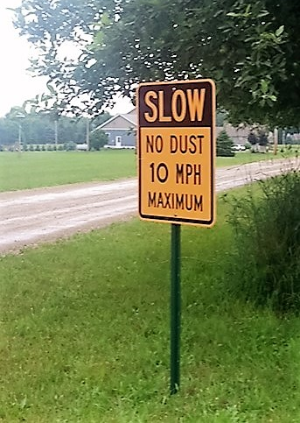
Dust Control (.1412)
Written plan for dust control submitted with application
Notes:
-The application shall be accompanied by a written plan for dust control.
-The permittee shall execute the plan.

Slide 17

Fire Prevention & Control (.1413)
Written plan for fire prevention and control provided with application
Notes:
-The application shall be accompanied by a written plan for fire prevention and control.
-Highly recommend working with the Fire Marshal.

Slide 18
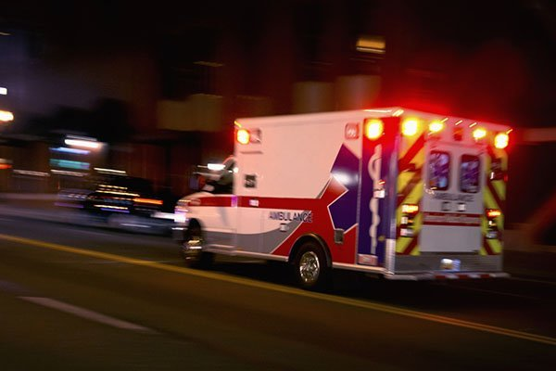
Plans for Emergency (.1414)
Written plans for dealing with emergency situations:
Incidents that require rapid evacuations
Use of emergency egress roads
Notes:
-The application shall be accompanied by written plans for dealing with emergency situations involving the occurrence of incidents requiring rapid evacuation, including arrangements for use of emergency egress roads.

Slide 19
Provisions of Medical Care (.1415)
Written plan for medical care:
Submitted with application and approved local health director
Name, address, and signed/notarized statement from the licensed physician accepting responsibility.
Number of licensed physicians, nurses, and other staff on duty during event
Structure(s) providing at least 450 square feet of space with running water under pressure from approved source
List of medical supplies/equipment provided
Notification of public hospitals with 20 miles
Name, address, and signed/notarized statement from licensed ambulance service providing emergency transportation
Notes:
-The application for permit shall be accompanied by a written plan for the provision of medical care, such plan having been approved in writing by the local health director.
-At the time of the inspection, the structure and all supplies and equipment provided for in the plan shall be in place; and the agreements and statements provided for in the plan shall be determined to be valid.
-The plan shall include provisions for:
the name and address of a physician licensed to practice medicine in North Carolina to be responsible for the organization and delivery of emergency medical services; A signed notarized statement by the physician accepting the responsibility shall accompany the plan. He shall determine how many licensed physicians, licensed nurses, and other medical personnel shall be on duty on the premises at any particular time;
at least one enclosed covered structure to be used as a medical treatment center; The structure or structures shall provide at least a total of 450 square feet and shall have running water under pressure from an approved source;
a list of medical supplies and equipment sufficient to support reasonably anticipated medical care requirements;
notification of all general public hospitals within 20 miles of the mass gathering location as to scheduled dates and anticipated attendance of the mass gathering;
the name and address of at least one licensed ambulance service agency to be responsible for providing emergency transportation; a signed notarized statement by an official of the agency accepting the responsibility shall accompany the plan.

Slide 20

Water Supply (.1416)
Water supply:
Approved source
Emergency source provided where necessary
Dispensing and distribution systems approved
Bacteriological/chemical water samples collected and approved
At least 1.0 ppm chlorine residual provided at all outlets during event
System protected against intentional contamination
Notes:
-There shall be provided a water supply from an approved source.
-An approved emergency source shall be provided in addition where necessary.
-Facilities approved by the Department for the distribution and dispensing of water shall be provided.
-The sponsor shall have in his possession, at the time of inspection, the reports of bacteriological and chemical examinations of water samples performed by the Division of Laboratory Services or another laboratory certified by the Department to perform such examinations.
-The water shall be chlorinated so as to provide a free chlorine residual of at least 1.0 part per million at all outlets at all times during the gathering.
-Water shall be obtained from a public or community water supply approved by the Department.
-If a new source of water supply is to be provided, the application shall be accompanied by the necessary plans, engineer's report, and specifications (in triplicate) as required for review and approval by the Department. The application shall include plans, engineer's report, and specifications for an emergency source capable of supplying at least three gallons per day per person.

Slide 21

Water Supply (.1416)
For drinking & washing:
At least 3 gallons per person/day
1 ½ pints per person during peak hour
For drinking, washing, & bathing:
At least 12 gallons per person/day
6 pints per person during peak hour
Notes:
-If water is to be provided only for drinking and washing, water shall be supplied at a rate of three gallons per person per day and a peak hour demand of one and one-half pints per person.
-If water is to be provided for drinking, washing, and bathing, water shall be supplied at a rate of 12 gallons per day per person and a peak hour demand of six pints per person.
-Water shall be obtained from a public or community water supply approved by the Department.

Slide 22
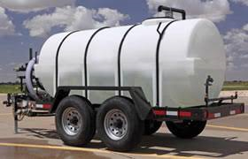
Water Supply (.1416)
If water hauled from off-site:
Adequate storage facilities provided
Tanks cleaned and sanitized (100 ppm chlorine for at least 24 hours)
Water must be from an approved source
Tanks protected from contamination
Notes:
-If water is to be hauled from an off-site source, storage facilities shall be provided in the area sufficient in volume to supply the needs of the gathering for its duration. Before being filled with water for use during the gathering, all such storage tanks shall be cleaned thoroughly, filled with clean water containing a chlorine residual of at least 100 parts per million, and, after a contact time of at least 24 hours, all such tanks shall be emptied. Subsequently, and prior to the issuance of a permit, all such tanks shall be filled with water from an approved source and all inlets to such tanks shall be closed and locked so as to give positive protection against the introduction of contamination.
-Water outlets shall be provided at an adequate number of convenient and readily accessible locations properly distributed throughout the activity and camping areas.

Slide 23
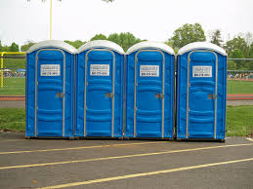
Toilet Facilities: Sewage Disposal (.1417)
Toilet facilities:
Convenient and readily accessible
No more than 100 persons per toilet seat
Chemical toilet rental service allowed, statement of how waste will be disposed of
Trench latrines covered, fly-tight seat boxes, hinged lids
Notes:
-Sanitary toilet facilities shall be provided at convenient and readily accessible locations properly distributed throughout the activity and camping areas at a rate of not more than 100 persons per toilet seat.
-If chemical toilet rental service is to be employed, all toilets shall be so located as to be readily accessible by service vehicles and shall be serviced as often as necessary. Material removed from such toilets shall be disposed of in a public or community sewerage system, or in a disposal trench to be constructed in the area. Each load of material deposited in such trench shall be covered immediately with earth or lime. At the end of each 24-hour period, the material shall be covered with a layer of at least six inches of earth.
-If trench latrines are to be used, all trenches shall be covered with fly-tight seat boxes with hinged lids.

Slide 24
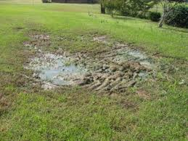
Toilet Facilities: Sewage Disposal (.1417)
Wastewater:
Public/community system with statement from DEM that facilities are adequate to handle flow from the event
Cannot be discharged onto the ground or into watercourse without approval from DEM
Notes:
-If water-carried sewerage facilities are provided, the sewer system shall be connected to a public or community sewerage system having wastewater treatment facilities of adequate capacity to treat the flow of wastewater from the mass gathering. The application shall be accompanied by a signed statement by the Division of Environmental Management attesting to the adequacy of the treatment facilities. A similar statement shall accompany the application if material removed from chemical toilets is to be disposed of in a public or community sewerage system. No sewage shall be discharged to the surface of the ground or into any watercourse without the approval of the Division of Environmental Management.

Slide 25
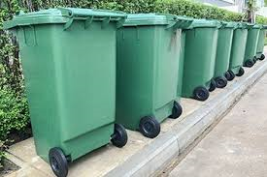
Solid Waste Collection and Disposal (.1418)
Solid waste:
Collection facilities adequate
Stored in leak-proof, non-absorbent containers
Removed at least daily or more often as needed
Disposal at approved disposal facility or on-site landfill
In landfill, compact waste and cover each day with at least 6 inches of dirt
Notes:
-Facilities shall be provided for all solid wastes to be collected and stored in leak-proof, non-absorbent containers, and all solid wastes shall be removed daily or more often and disposed of in a community solid waste disposal facility or in a sanitary landfill to be constructed in the area. Solid wastes shall be placed in the landfill, compacted as densely as possible, and covered after each day of operation with a compacted layer of at least six inches of dirt.

Slide 26
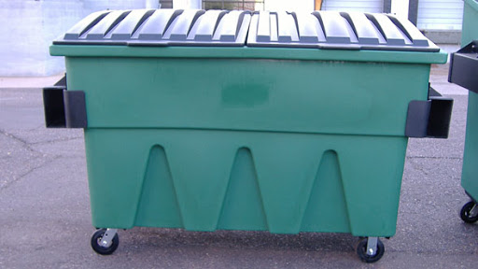
Solid Waste Collection and Disposal (.1418)
Containers (32 gallon max) placed at camping/parking, food service, and other areas where required
For bulk storage:
At least two containers (four cubic yards) per 1,000 person if removed daily
At least two containers (two cubic yards) per 1,000 people if removed twice-daily
Accessible to solid waste vehicles
Notes:
-Approved receptacles having a maximum capacity of 32 gallons shall be provided at places conveniently located throughout the activity, camping and parking areas, and at each food service facility for the deposition of solid wastes.
-If bulk solid waste storage containers are used, at least two four-cubic-yard containers shall be provided per 1,000 persons in the case of once-daily removal, or two two-cubic-yard containers per 1,000 persons in the case of twice-daily removal, and these containers shall be so located as to be accessible to solid waste service vehicles.

Slide 27
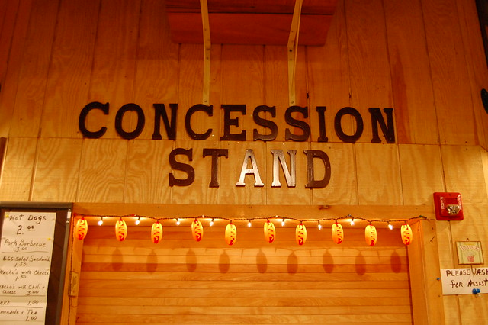
Food Dispensing (.1419)
Food dispensing facilities:
Accessible and convenient, sanitary condition
Perishable food items limited to pre-packaged items prepared in a permitted establishment
Food-handling conducted on-site must be in compliance with .2600 Rules (TFE permit)
Perishable foods stored at 45ºF or frozen until heated/cooked for service
Notes:
-Sanitary food dispensing facilities shall be provided at accessible and convenient locations, and shall be maintained in a sanitary condition.
-Perishable food items dispensed from such facilities shall be limited to prepackaged items, such as wrapped sandwiches, prepared in commercial establishments and under official sanitary supervision, and shall be dispensed in the unbroken packages; provided, that chicken, hamburgers, and frankfurters obtained from approved sources may be cooked and packaged at the site if all operations of preparation, cooking and packaging in unit packages for dispensing to individuals are done inside an approved structure or vehicle, in a sanitary manner, and otherwise in compliance with the "Sanitation of Restaurants and Other Food-handling Establishments," .2600. (TFE permit)
-Perishable foods shall be stored at or below 45 F, or in the frozen state, until heated or cooked immediately before serving.

Slide 28



Insect and Rodent Control (.1420)
No fly or mosquito breeding places, rodent harborages, or undrained areas on premises
Necessary measures shall be taken to control flies, mosquitoes, rodents, or other vermin
Notes:
-There shall be no fly or mosquito-breeding places, rodent harborages, or undrained areas on the premises.
-Necessary measures shall be taken to control flies, mosquitoes, rodents, or other vermin.

Slide 29
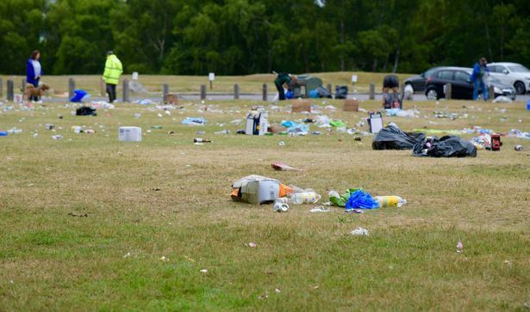
Post-Gathering Clean-up (.1421)
Within one week after gathering:
Sanitary landfills, trenches, and pits covered with at least two feet of compacted earth material
All litter and solid wastes removed from the area
Signs, litter, and solid wastes related to gathering removed from roads removed within one mile of the site
All temporary facilities removed, unless otherwise directed by property owner
Notes:
-Within one week after the end of the gathering, all sanitary landfills and any trenches or pits used for sewage and liquid waste disposal shall be covered with at least two feet of compacted earth material; and the areas and immediate surrounding properties shall be cleaned of all litter and solid wastes attributable to the mass gatherings. In addition, any signs, litter, and solid wastes on roads leading from the areas and within one mile of the areas and which can be attributed to the mass gathering shall be removed.
-All solid wastes shall be disposed of as provided in .1418 of this Section.
-Unless otherwise directed by the owner of the property, all temporary facilities (such as solid waste receptacles and signs) shall be removed from the areas.

Slide 30
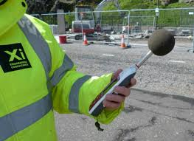
Noise Level at Perimeter (.1422)
Plans submitted with application certifying:
Noise level at the perimeter of the site no more than 70 decibels on the A scale of a certified sound level meter
Signed statement certifying that noise level limit will not be exceeded
Notes:
-The application shall be accompanied by detailed plans for amplifying equipment, which shall be so located and operated as to limit the noise level at the perimeter of the site to no more than 70 decibels on the A scale of a sound level meter which meets the specifications of the American National Standards Institute, which are adopted by reference in accordance with G.S. 150B-14(c).
-The applicant shall include a signed statement certifying that the noise level limit as herein specified will not be exceeded

Slide 31
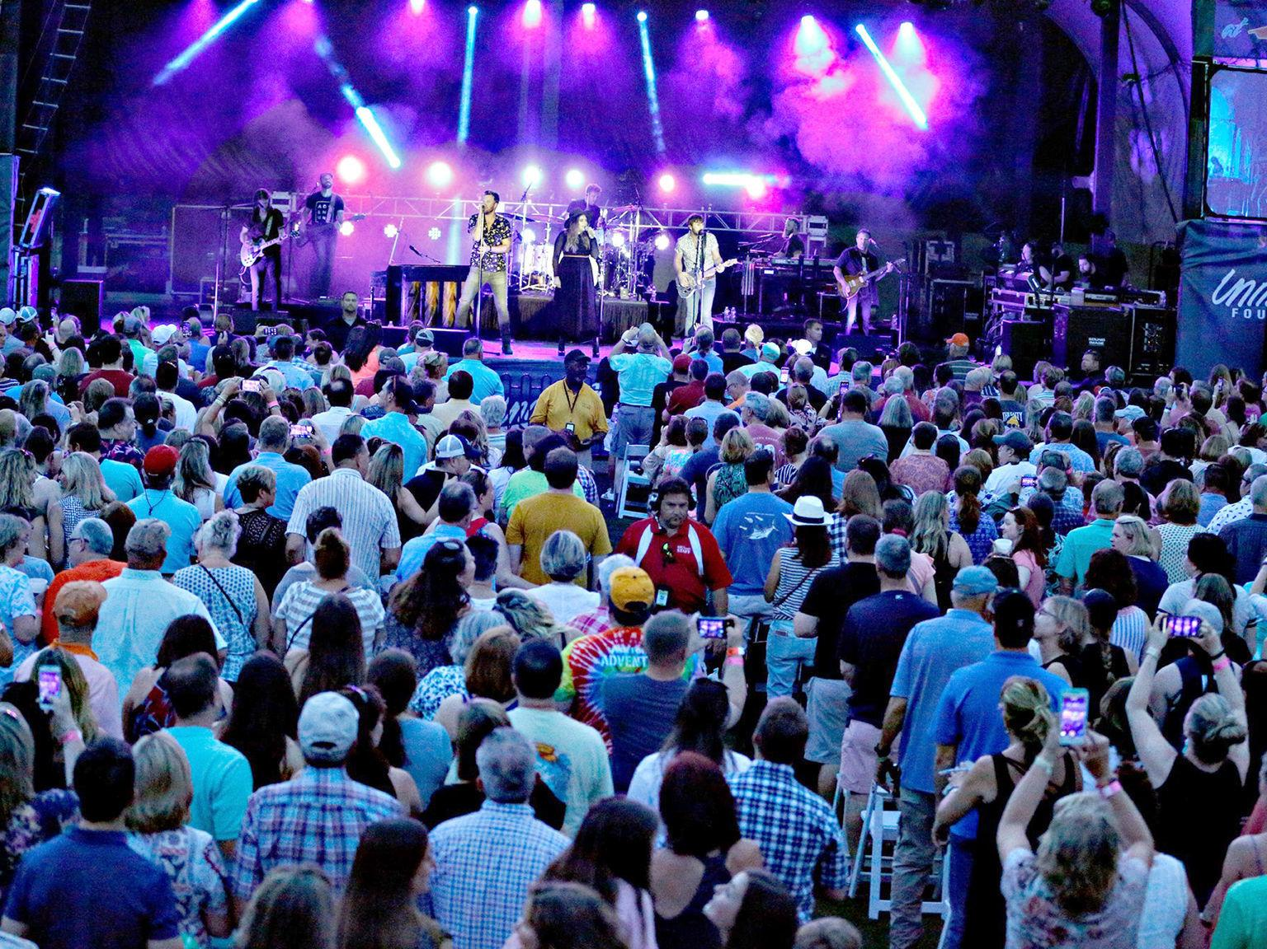
Lighting (.1423)
Application shall be accompanied by detailed plans for lighting designed to illuminate the site
Notes:
-Application shall be accompanied by detailed plans for lighting designed to illuminate the site.

Slide 32


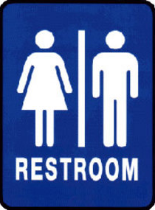
Signs (.1424)
Signs posted for locations of:
Toilet facilities
Water supply outlets
Solid waste receptacles
Food stands
First aid facilities
Command post
Notes:
-Signs shall be posted throughout the area showing the locations of toilet facilities, water supply outlets, solid waste receptacles, food stands, first aid facilities, and the command post.

Slide 33
End of Presentation
If you have questions about this presentation, please contact your Regional Specialist.
Notes:
-This is the end of this presentation.
-If you have any questions, please contact your Regional Specialist.

