Slide 1
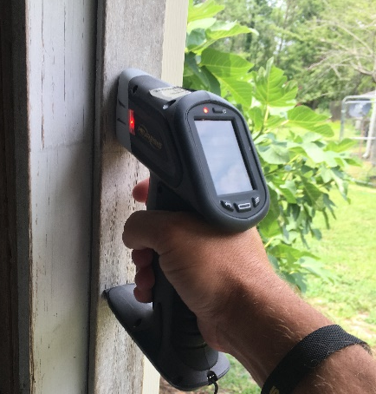


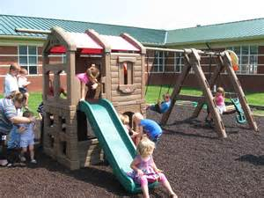
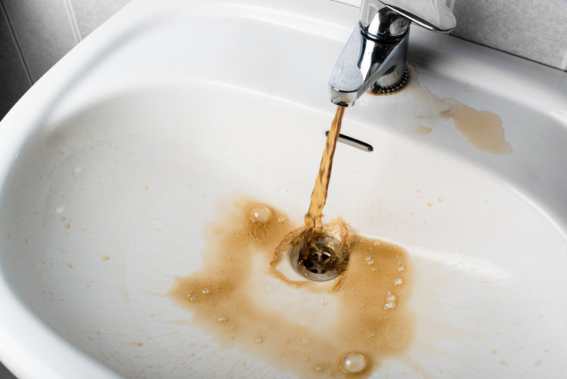
CEH
Educational Meeting
April 19, 2022
Children’s Environmental Health Updates

Slide 2
Presenters
Children’s Environmental Health Program
Environmental Health Regional Specialists
North Carolina DHHS/DPH
http://ehs.ncpublichealth.com/hhccehb/cehu/
Google “CEHB” to find program
Notes:
Also under Highlights farm to table info.

Slide 3
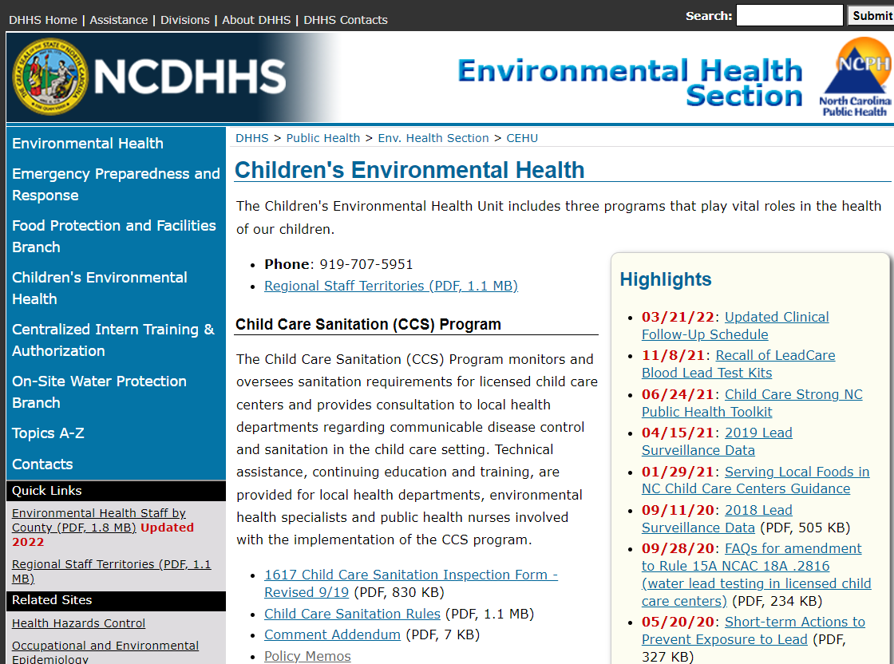
Notes:
Also under Highlights farm to table info.

Slide 4
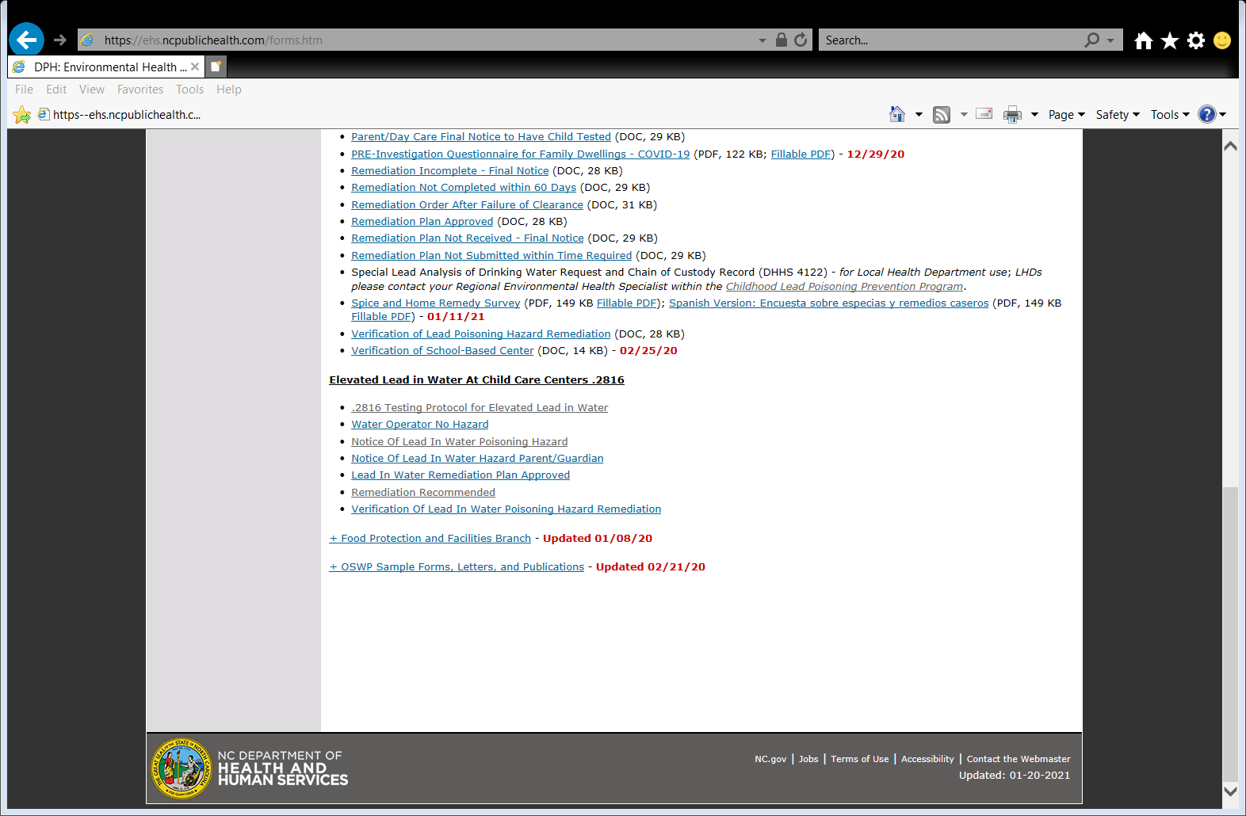
Notes:
Under Lead .2816 forms.

Slide 5
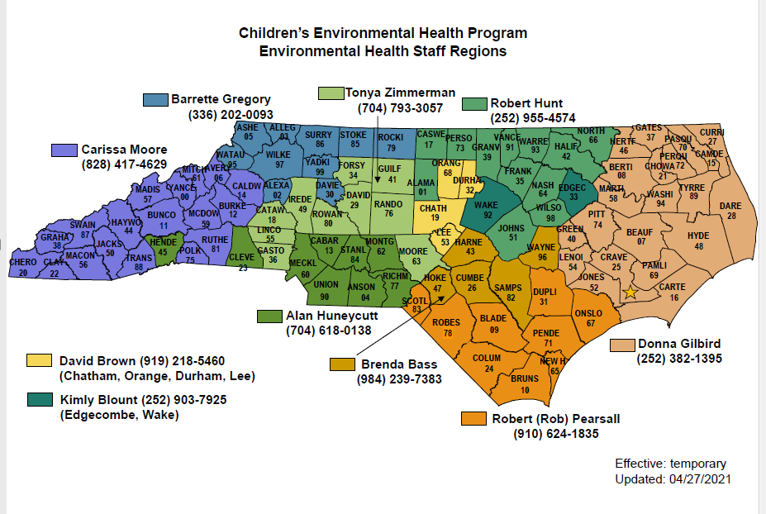
Notes:
Changes at 4/19/22

Slide 6
New Hire!
New Regional Specialist has joined CEH Team - Nykesse Roberts February 2022
New territory changes will be effective June 1, 2022.
During this transition period, attempt to close out older cases with current Regional Specialist.
Counties in Nykesse’s area will continue to work and coordinate efforts with current regional specialist until further notice.

Slide 7
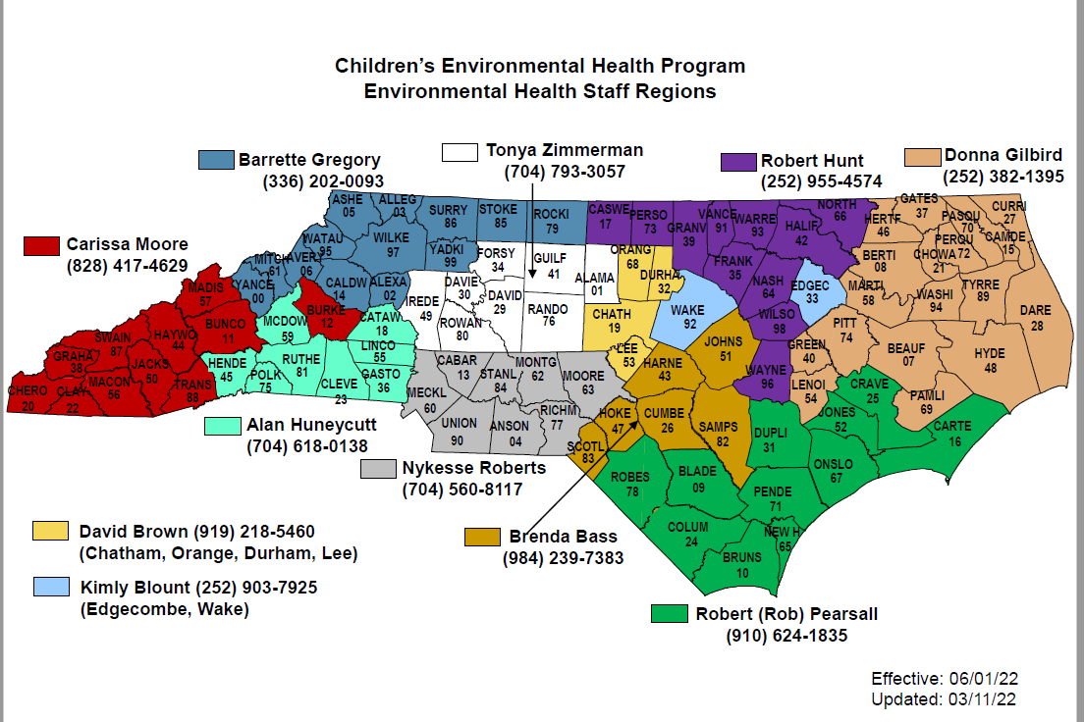
Notes:
Changes at 4/19/22

Slide 8
Introduction
CEH Regional Staff
& Other CEH Staff

Slide 9
CEH Program Updates
Future of WIIN Grant, Child Care Lead in Water Testing .2816 (Ed Norman)
New legislation, Senate Bill 105 included $150,000,000 in funds from American Rescue Plan Act (ARPA) (Ed Norman)
Session Law 2021-69 Revise Health Standard for Lead (H272)
Current Protocol for Lead in Water Testing .2816
Emerging Child Care Issues
Child Care Rules Re-Adoption
Lead Poisoning Prevention
Notes:
“Water Infrastructure Improvements for the Nation (WIIN)

Slide 10
Session Law (H272)
Effective December 1, 2021
Session Law 2021-69 Revise Health Standard for Lead (H272)
Amends the “Lead poisoning hazard” definition of lead in drinking water (GS 130A-131.7(7)) to a concentration equal or greater to 10 ppb (formerly, 15 ppb). The clearance level of lead in drinking water for remediation plans has also been reduced to 10 ppb (GS 130A-131.9C(i)).
Question: What if previous test results prior to Dec 1st of 2021 exceeded 10ppb but were less than 15ppb? Will this affect the current sanitation inspection?

Slide 11
.2816 Lead in Water Testing Overview
Required testing of all fixtures used for drinking and food preparation within 1 year, once every 3 years, within 30 days of renovation or repairs that impact water infrastructure, and during the license application process.
All testing completed per EPA 3T’s Guidelines.
Testing was initially to be completed by October 1, 2020.
Delay in WIIN Grant Award.
Delay due to COVID.
Testing began around June 2020.
Most testing was completed by June 2021.
Currently new WIIN Grant funding being pursued for Cycle 2 testing. (Ed Norman)

Slide 12
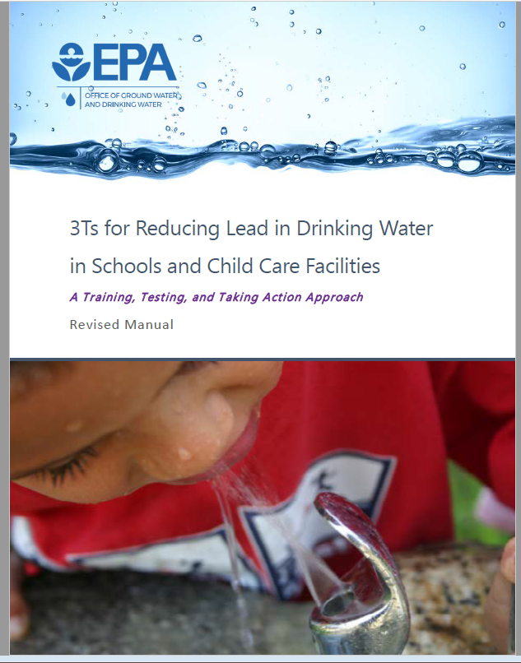
.2816 Lead in Water Testing Overview
EPA 3T’S Requires
Use 250ml bottles
STAGNATION PERIOD BETWEEN 8-72 HOURS. (3Ts 8 – 18 hours)
COLLECT WATER SAMPLES BEFORE THE FACILITY OPENS AND BEFORE ANY WATER IS USED. (Monday Preferred)
FOLLOW-UP SAMPLING COMPLETED BY DEPARTMENT OR LOCAL HEALTH DEPARTMENT.
FOLLOW-UP COLLECT FIRST DRAW AND 30 SECOND FLUSH.
Notes:
Google EPA 3T’s
First round by operators.
At or above 15ppb follow-up now 10ppb

Slide 13
.2816 Lead Water Testing
Update As of April 2022
4,307 Centers Enrolled
4,123 Centers Tested
23,611 Total Samples Analyzed
Notes:
4400

Slide 14
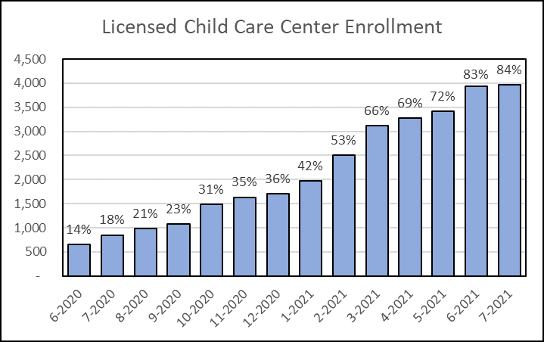
Notes:
Most enrolled as required by6/21

Slide 15
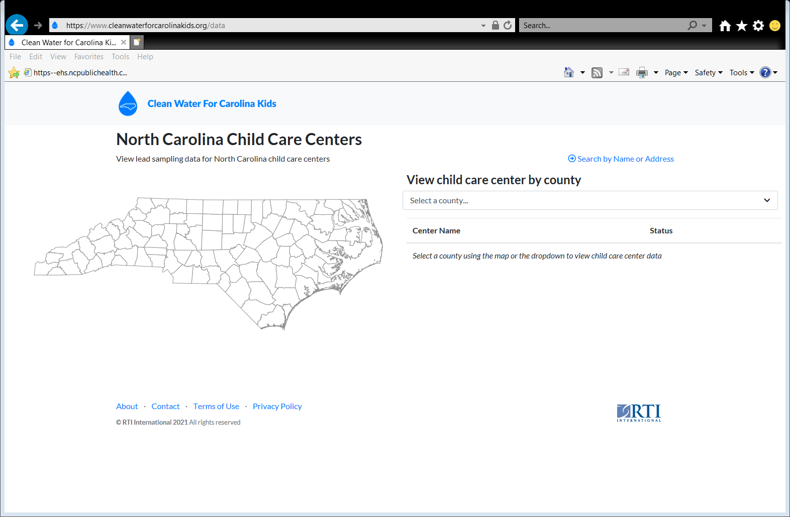

Slide 16
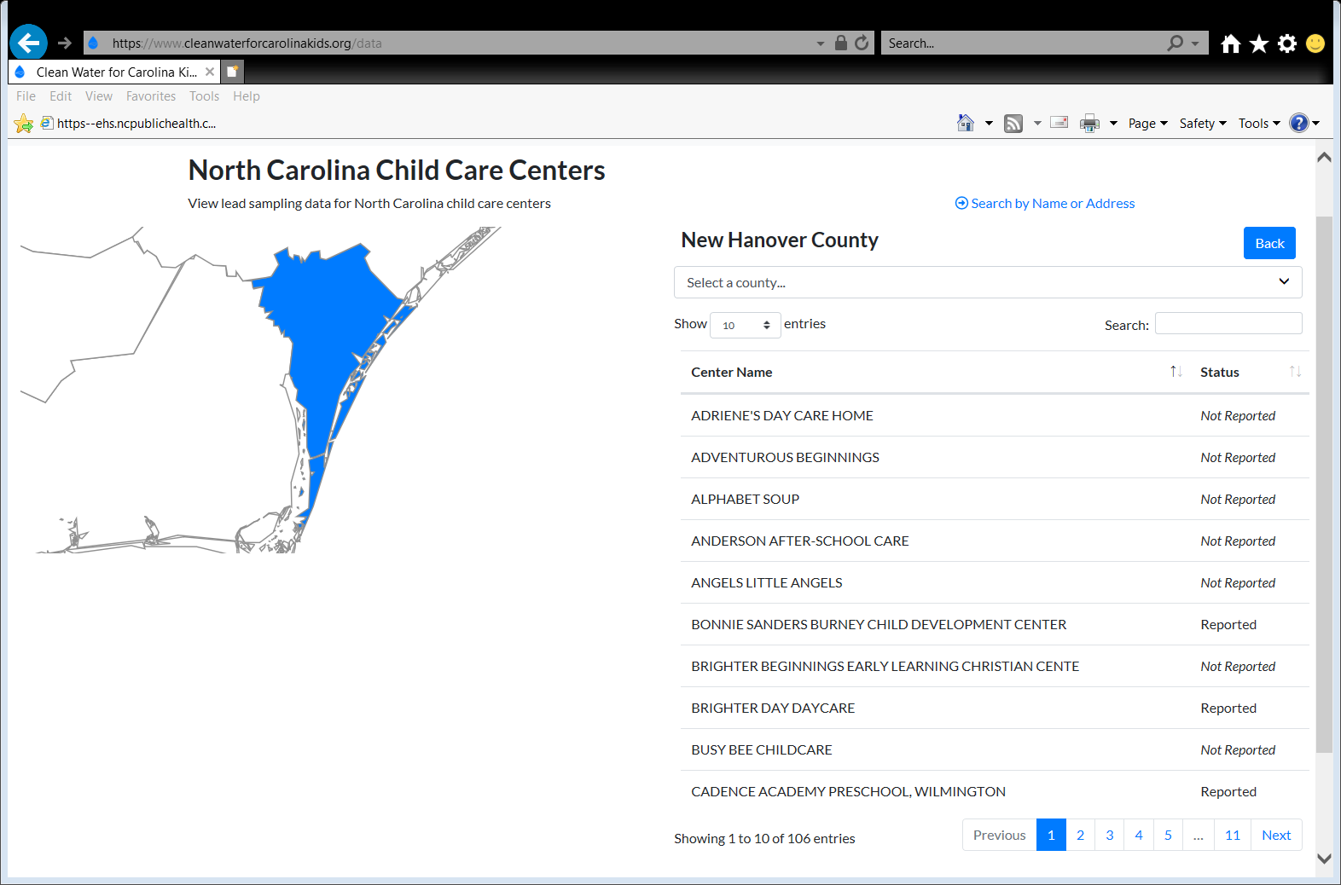

Slide 17
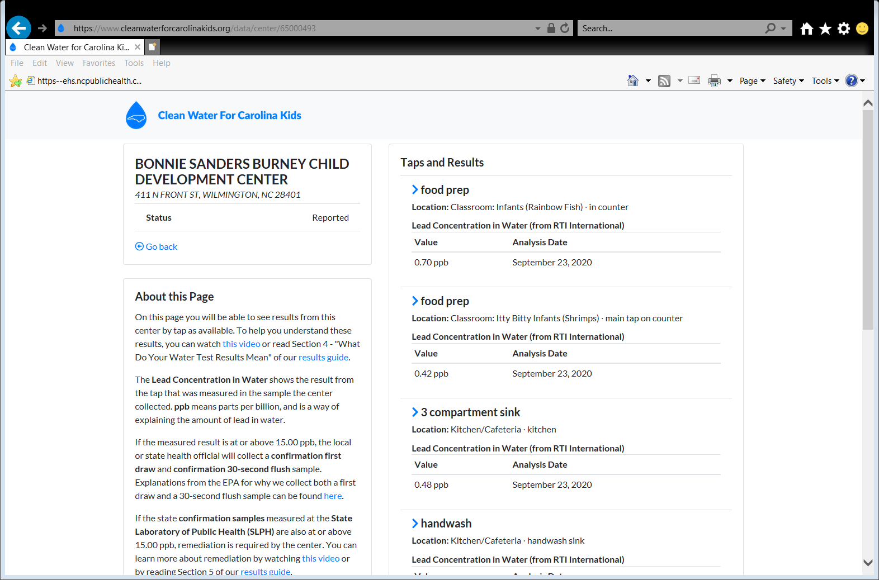
Notes:
Will also show Follow-up and Post Remediation Sampling if collected.

Slide 18
CONCERNS DURING PROGRAM
Some centers did not complete sampling.
Centers did not sample all required fixtures.
  Outlets Used for Drinking Water and Food Preparation
Centers sampled fixtures not used for drinking water or food preparation.
    Examples:
    Handwash sinks in classroom
    Mop sinks
Centers were closed for extended periods due to COVID.
Centers were opened but some fixtures were not being used.

Slide 19
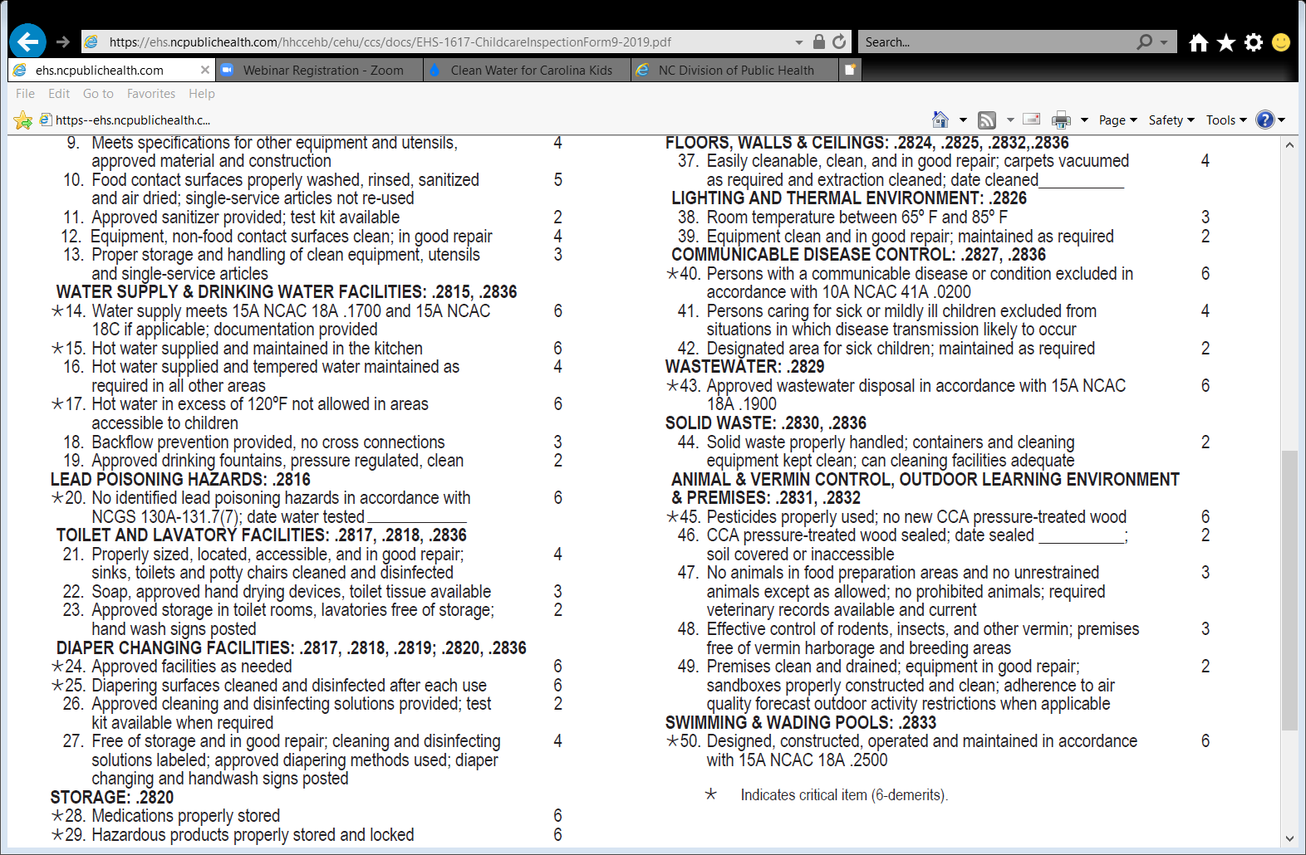
Protocol :
Centers that have not completed sampling
Effective July 1st of 2021 centers that have not completed sampling may be placed in provisional classification.
Centers placed in provisional classification, must complete testing prior to 7-day re-inspection or will be placed in disapproved. (Must be able to verify testing has occurred. Results may not be available during re-inspection.)

Slide 20
Protocol:
Centers have not sampled all required fixtures (Drinking Water and Food Preparation)
Review sampling data during inspection or prior to inspection on RTI Mapper. https://www.cleanwaterforcarolinakids.org/data
Verify that initial sampling has occurred.
General comment that missed fixtures, including water fountains, must be tested by next sanitation inspection. Strongly recommend centers use fixtures that were tested.
Provisional Classification for next inspection if fixtures not tested.
Should Contact RTI or a Certified Laboratory(Must Use 3T’s Methodology).
Notes:
Giving time to correct due to messaging
One kit per center.
Ask to complete by next inspection

Slide 21
Protocol:
Centers sampled fixtures not used for drinking water or food preparation
If result is below 10 ppb no action required.
“Elevated samples inside the facility shall be re-sampled even if collected from a handwash lavatory or a bathroom lavatory by the operator. Utility room mop sinks and outside faucets will not need to be re-sampled if determined they are not utilized for drinking or food preparation.”
If the follow-up sample results are at or above 10 ppb mitigation is required, regardless if fixture is utilized for drinking water or food preparation.
Notes:
Do not want to leave known Lead hazards in centers.

Slide 22
Protocol:
Centers sampled fixtures not used for drinking water or food preparation
Restrict Access
Elevated hand wash sinks, which were tested by the operator and determined not to be used as a source of water for drinking or food preparation, may continue to be used for hand washing. Signage must be posted at the hand wash lavatory to prohibit any consumption of the water.
Sinks will still require mitigation.
Notes:
Do not want to leave known Lead hazards in centers.

Slide 23
Protocol:
Centers were closed
If centers were closed during program, they should sample upon re-opening.
Ensure all fixtures are flushed after re-opening and before sampling.
Follow CDC Guidelines for re-opening: https://www.cdc.gov/coronavirus/2019-ncov/php/building-water-system.html
Follow EPA Guidelines for periods of low or no use of building water: https://www.epa.gov/sites/production/files/2020-05/documents/final_maintaining_building_water_quality_5.6.20-v2.pdf
Notes:
Some after school and pre-k centers did not re-open till 9/21

Slide 24
Protocol:
Centers That Were Opened But Had Fixtures not being used During Sampling
All fixtures used for Drinking Water and Food Preparation should have been sampled. (water fountains)
Fixture not in use, should be flushed for 5 minutes 8-72 hours prior to sampling.
Follow previous protocol for missed fixtures.
Notes:
Ask to Sample prior to next inspection.

Slide 25

Key Take Aways Moving Forward to Cycle 2
Make sure centers are clear on sampling requirements.
Follow proper sampling protocols.
Sample required sinks.
Ensure clear messaging from all entities involved.
Notes:
All involved DCDEE, CEH, EHS, Operators RTI, private Labs.

Slide 26
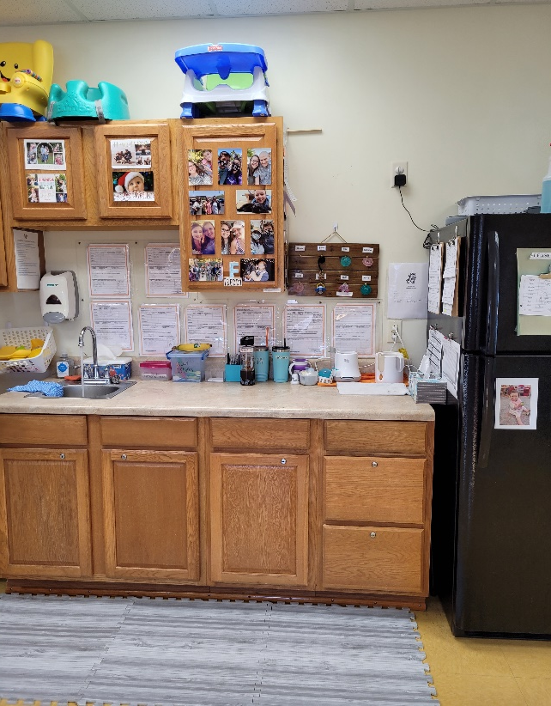
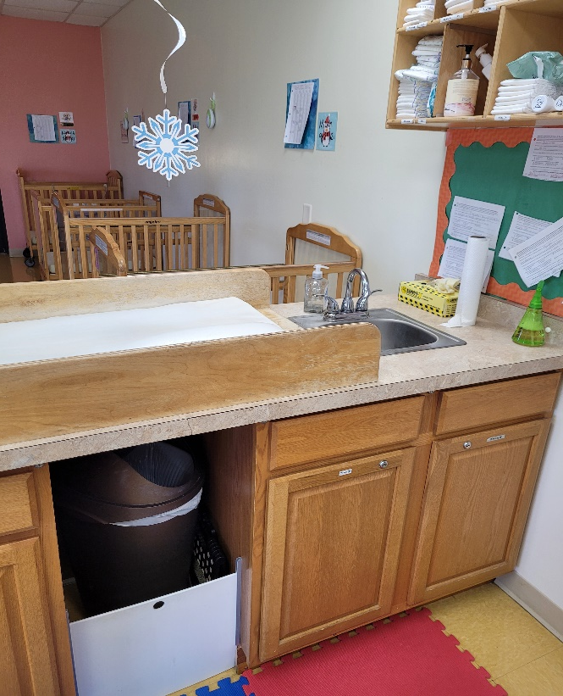
Child Care Sanitation Updates

Slide 27
Chemical Storage
15A NCAC 18A .2820 STORAGE
(b) All corrosive agents, pesticides, bleaches, detergents, cleansers, polishes, any product which is under pressure in an aerosol dispenser, and any substance which may be hazardous to a child if ingested, inhaled, or handled shall be kept in its original container or in another labeled container, used according to the manufacturer's instructions and stored in a locked storage room or cabinet when not in use.
Notes:
Current rule languge

Slide 28
COVID Related Chemicals
The pandemic has not negated the responsibility of child care operators to properly store chemicals when not in use.
Hand sanitizers are still required to be inaccessible when not in use. Balance must be maintained between readily available for usage and proper storage.
If disinfectants including bleach are donated to facilities, facilities must ensure that they have proper storage for these chemicals.
Chlorine disinfectants are allowed to be stronger than the 500-800 ppm (approximately 1,000 ppm). Still in effect since we remain in a state of emergency.

Slide 29
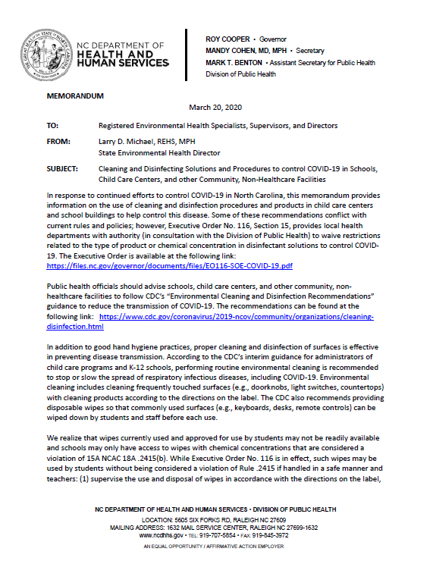
Executive Order

Slide 30

Chemical Storage
School-Based Centers
Effective March 8, 2021
For school-based centers, it is not considered a violation if hazardous products are left out in the cafeteria’s kitchen so long as:
Kitchen doors are ‘locked’ with a device approved by the local building/fire code inspector or Fire Marshal’s Office, and;
A restriction is placed on the license by the Division of Child Development and Early Education (DCDEE) prohibiting children from being in the kitchen for any purpose.
If both conditions are not attainable then hazardous products must be stored in accordance with Administrative Rule 15A NCAC 18A .2820.

Slide 31

Chemical Storage
School-Based Centers
For compliance with this new school-based policy issue:
Child care centers should contact their local building/fire code inspector or Fire Marshal’s Office to determine how to appropriately lock kitchen doors. (Determination should not be made by Env Health.)
Child care operators should also contact DCDEE to request the license restriction.

Slide 32
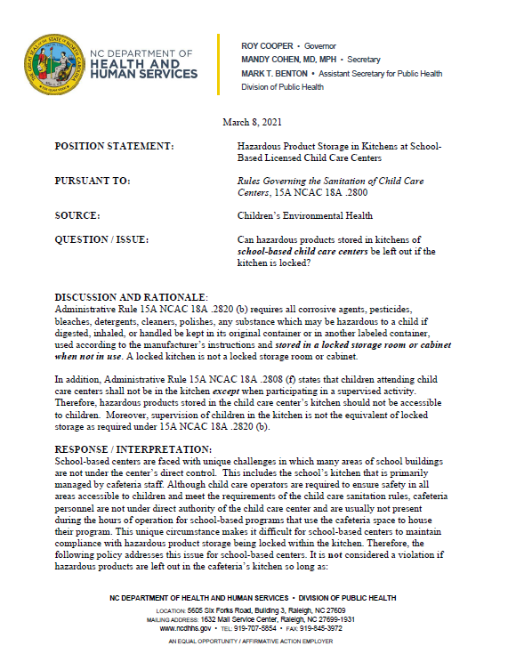

Slide 33
Other Chemical Issues
Multi Purpose Glass Cleaners are not approved to be used in lieu of detergent (soapy) solution for diaper changing.
Discuss this issue with the provider and give them options and a timeframe for compliance.
Note on comment addendum that the issue has been discussed and expectation of resolution by next inspection.

Slide 34
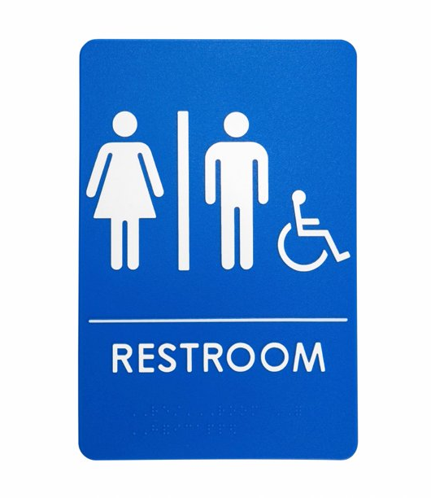

Other Chemical Issues
Chemical storage for restrooms must still comply with rule .2820 storage rule.
Locking of the bathroom door does not meet the requirement of locked “storage room or cabinet”.
This include those restrooms designated as staff restrooms. Note that many staff restrooms are also designated as the handicap accessible restroom and must be inspected for children access.
If encountered during an inspection, have operator correct the issue during the inspection by properly storing chemicals and make a note on the comment addendum.

Slide 35
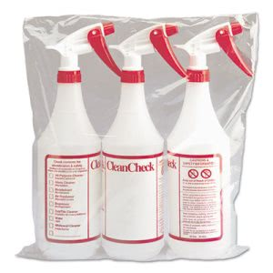
Other Chemical Issues
Color coding for chemicals can be used in addition to but not substitution for proper labeling.
Rule 2820 (b)All corrosive agents, pesticides, bleaches, detergents, cleansers, polishes, any product which is under pressure in
an aerosol dispenser, and any substance which may be hazardous to a child if ingested, inhaled, or handled shall be
kept in its original container or in another labeled container. T
2820(c)…..These solutions shall be labeled as sanitizing, disinfecting, or detergent (soapy water) solutions.

Slide 36

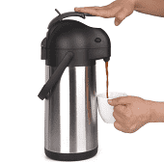
Hot Water Accessibility Issue
Water in areas accessible to children shall be tempered between 80°F (27°C) and 110°F (43°C). For handwash lavatories used exclusively by school-age children, the 80°F (27°C) minimum temperature requirement shall not apply. Hot water in an area accessible to any child, which is in excess of 120°F (49°C), shall be considered a burn hazard.
***Look for thermos type containers in food preparation areas used for bottle warming. The temperature of these insulated beverage dispensers can be in excess of 160°F. Deemed as a burn hazard when in use and temps in excess of 120°F.

Slide 37
Child Care Rules Re-Adoption
Completion by March 2024
§ 150B-21.3A. Periodic review and expiration of existing rules: requires our rules to be reviewed and re-adopted
Review process is required at least once every 10 years
Meetings have been held with stakeholders and the regulated community.
Committee is addressing public comments, incorporating policy memos and technical changes.
Rules being review by DPH

Slide 38
Child Care Rules Re-Adoption
Proposed technical changes:
  Updated language for definitions.
  Clarified Sanitizer and Disinfectant requirements.
  Defined food prep area and diapering area.
  Reorganized rules for beverages from home.
  Added mechanical refrigeration as a requirement for cold food storage
  Clarified Bulk food storage
  Changed bleach to chlorine solution
  Added “toys” in outdoor learning environment
  Changed DENR to DHHS and DCD to DCDEE

Slide 39
Child Care Rules Re-Adoption
Mirrored some items in food code
Proposed Food Code Related Changes:
  Updated cooking temperatures.
  No bare hand contact.
  Change re-heating utilizing microwaves.
  Updated hot holding temperatures.
  Mirrored language for ground/comminuted meats
  Require metal stem thin probe thermometer

Slide 40
Child Care Rules Re-Adoption
Other proposed change:
Included guidelines for response to vomiting or diarrheal events
Clarified change of use
Included water play requirements
Added language for equipment clean and in good repair
Clarified human milk storage
Added language for storage of hot foods sent from home in thermos like containers
Clarified completion of feeding
Clarified allowable bottle warming equipment and procedure
Requires a barrier if diaper changing is performed on the floor in toileting rooms

Slide 41
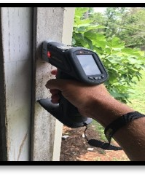
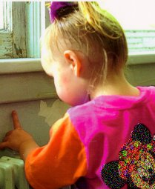

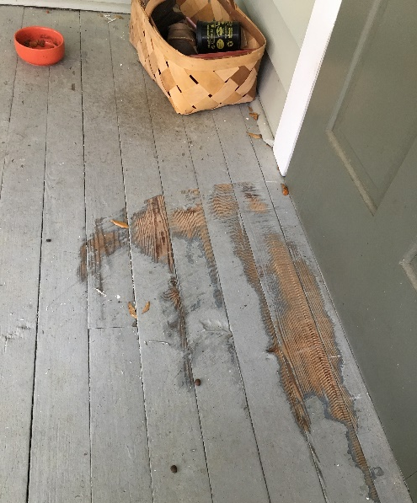
.3100 Lead Poisoning Prevention
Update

Slide 42
.3100 Rules Re-Adoption Process Completed
Effective April 1, 2021
Childhood Lead Poisoning Prevention Program .3100 Rules were Re-adopted:
  .3101 - Technical changes to definitions to align with EPA and HUD Guidelines.
  .3105 - Changes to clearance standards for soil to align with EPA Guidelines.
  .3107 – Clarified lead safety pamphlets that are required to be provided and additional language for interior horizontal surfaces.

Slide 43
New Follow up Schedule for Blood Lead Testing
Centers for Disease Control and Prevention (CDC) lowered the blood lead reference value (BLRV) for children from 5 micrograms per deciliter (μg/dL) to 3.5 μg/dL
NC Childhood Lead Poisoning Prevention Program has revised its follow-up schedule for blood lead levels of children under the age of six. (Melanie Napier & Tena Hand-Schafale)

Slide 44
Current Environmental Impact of New Reference Value
3.5 μg/dL to less than 5 μg/dL Clinical follow up only – No investigation
EBL 5μg/dL to less than10 μg/dL –
Offer investigation
CLP greater than or equal to 10 μg/dL – Required investigation

Slide 45
CEH Scheduled Training
Child Care SOP
  September 7-9, 2022 (Kannapolis)
Lead Poisoning Prevention SOP
    October 26-28, 2022 (Asheboro)
Proposed NC Lead Training (TBA)

Slide 46
Questions?

