Slide 1
NC Department of Health and Human Services Disaster Recovery Assessment for Child Care Centers
Building Resilient Environmental Health Capacity (BREHC)
Joyce Keith Hargrove, PhD
Environmental Program Consultant
Stephanie Mar
Social Research Assistant II
April 19, 2022

Slide 2
Presentation Overview
BREHC Overview
Purpose of Disaster Recovery Assessment
Assessment Form Development & Results
Post-Disaster Sanitation Assessment Form Preview
Questions
SOURCE:

Slide 3
Building Environmental Health Capacity (BREHC)
CDC Cooperative Agreement that aims to improve the state’s capacity to detect, identify, and prevent exposures to environmental hazards

Slide 4
BREHC Components
Component A - core capacity to use EH data
Component B - access to safe drinking water from private wells
Component C – fortify EH resilience in response to natural disasters

Slide 5
Purpose of Post-Disaster Sanitation Assessment Form
Centers and DCDEE Consultants rely on environmental health specialists (EHS) to assess on-site health hazards and report concerns
Natural disasters may create environmental hazards:
prevent child care centers from safely operating
present potential hazards not addressed in routine sanitation assessments
Distribute a standardized form to conduct post-disaster sanitation assessments for child care centers

Slide 6
Assessment Form Development
Goal: Learn about existing protocols and experiences of EHS who may have assessed child care centers after a disaster or unintended closure
Online survey distributed in July 2021
Total responses: 115 (estimated 20-25% response rate)

Slide 7
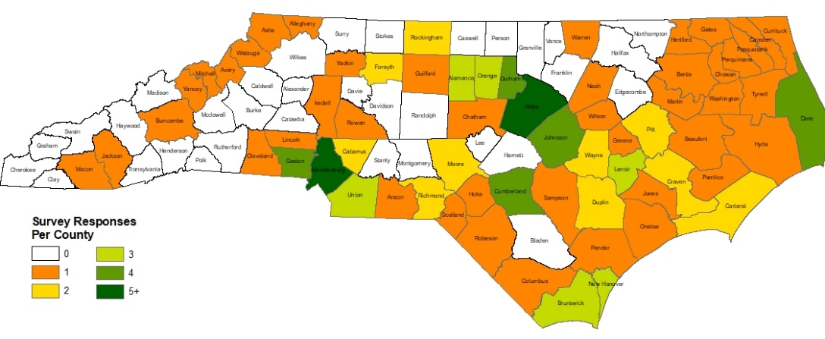
Survey Results
A majority of respondents service the east and southern regions of the state

Slide 8
Survey Results
Storms were the most common natural disaster reported, followed by hurricanes and flooding
Table 1: Most Common Regional Natural Disaster
 | % of Responses | # of Responses
Storms | 46.24% | 43
Hurricanes | 26.88% | 25
Flooding | 18.28% | 17
Blizzards or snowstorms | 4.30% | 4
Intense winds (non-tornado) | 3.23% | 3
Tornados | 1.08% | 1
Earthquakes | 0.00% | 0
Landslides or mudslides | 0.00% | 0
Wildfires | 0.00% | 0
I do not know. | 0.00% | 0
Total # of Responses | 93

Slide 9
Survey Results
Water supply issues and power outages were selected as the two most common scenarios that could lead to an unplanned closure
Table 2: Common Unplanned Closures
 | % of Responses | # of Responses
Power outages | 19.46% | 65
Communicable disease outbreak | 17.96% | 60
Water supply shortage or loss of water | 12.57% | 42
Water supply contamination | 10.18% | 34
Ice or frost | 9.58% | 32
Wastewater system malfunction | 9.58% | 32
Structural damage/failure | 7.49% | 25
Fire (non-wildfire, such as kitchen fires or electrical fires) | 6.89% | 23
Extreme heat | 3.89% | 13
Other (see Appendix C) | 2.40% | 8
Staffing limitations | 0.00% | 0
I do not know. | 0.00% | 0
None of the above | 0.00% | 0
Total # of Responses | 334

Slide 10
Survey Results
Greatest concerns for EHS when a Center needs to reopen:
Power outages or power supply,
Food storage and handling,
Water supply,
Wastewater systems, and
Mold and mildew growth due to water damage or standing water
Notes:
.

Slide 11
Post-Disaster Assessment Form Preview
Guides EHS through the assessment process by categorizing the form by risk
Primarily check boxes, with follow up questions for written details and ample space for comments
Pairs with a remediation guidance document for child care center operators
Notes:
From these responses, a post-disaster sanitation assessment form was developed. It focuses on the concerns just highlighted and attempts to capture the necessary information to communicate to the Division of Child Development and Early Education (DCDEE).
I’ll switch my screen now to the form, so you can get a preview of what it will look like:
The form is divided into several sections that guides the EHS through the assessment process.
It is primarily check boxes for ease of response, but also includes ample space for comments.
This form will also be paired with a document with specific guidance for child care center operator. For example, how to handle food during boil water advisories, how to remediate water damage and potential mold growth, etc.

Slide 12
Assessment Form Feedback Request
We need your feedback!
Please respond by May 6th, 2022
Feedback Link: https://unc.az1.qualtrics.com/jfe/form/SV_dnG07TevSL8FNJA

Slide 13
Questions?

Slide 14
Thank you!
Joyce Keith Hargrove, Ph.D.
joyce.hargrove@dhhs.nc.gov
Stephanie Mar
stephanie.mar@dhhs.nc.gov

